Slide 1
Predicting Electricity Demand using Weather Data
Robert Gramillano

Slide 2
Outline
Abstract
Data Wrangling and Cleaning
Exploratory Data Analysis
Machine learning and modelling
Using RNNs and LSTM
Comparison to other forecasts
Conclusion

Slide 3
Outline
Abstract
Data Wrangling and Cleaning
Exploratory Data Analysis
Machine learning and modelling
Using RNNs and LSTM
Comparison to other forecasts
Conclusion

Slide 4
Why care about electricity demand?
Energy companies rely on accurate forecasts to predict upcoming demand.
An improved forecast helps energy companies take next steps to fully capitalize on and perhaps better brace for large spikes in electricity demand.
The goal of this project is to train a machine learning model on weather/electricity data to generate a more nuanced energy-demand forecast.

Slide 5
Outline
Abstract
Data Wrangling and Cleaning
Exploratory Data Analysis
Machine learning and modelling
Using RNNs and LSTM
Comparison to other forecasts
Conclusion

Slide 6
Scope of the project: Electricity Data
Hourly electricity and weather data gathered from both the Seattle and Los Angeles metropolitan areas
Electricity demand data was retrieved using the Energy Information Administration’s (EIA) API
LA electricity data gathered from Los Angeles Department of Water and Power, Seattle from Seattle City and Light
Data from July 2015 to September 2018

Slide 7
Scope of the project: Weather Data
Hourly weather data was retrieved from the National Oceanic and Atmospheric Administration’s (NOAA) website
Local Climatological Data (LCD) was obtained for both LA and Seattle metropolitans
LCD data includes, heating degree days, relative humidity, pressure, temperature, etc.

Slide 8
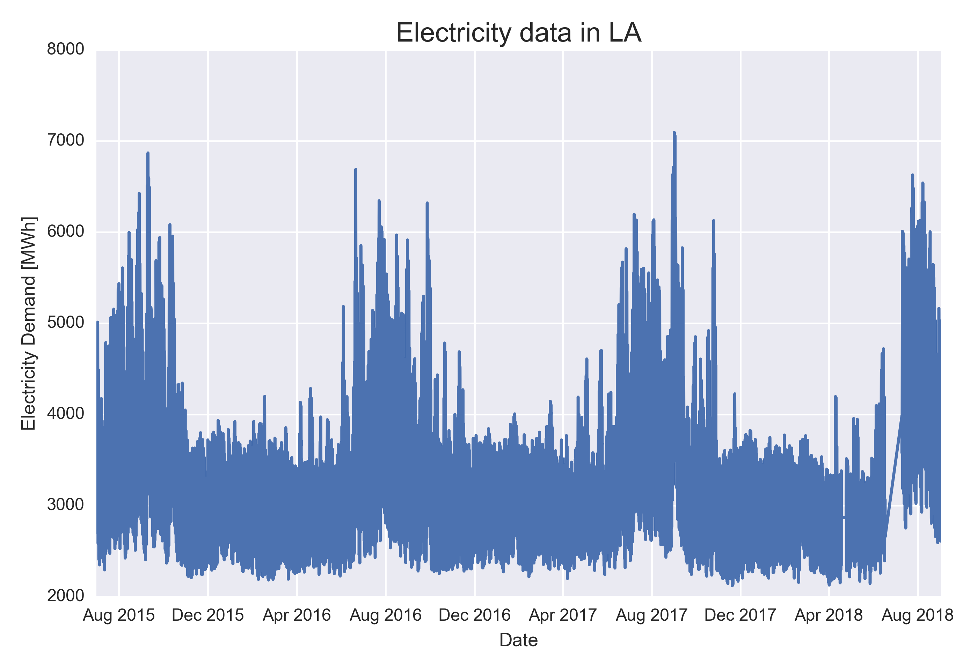
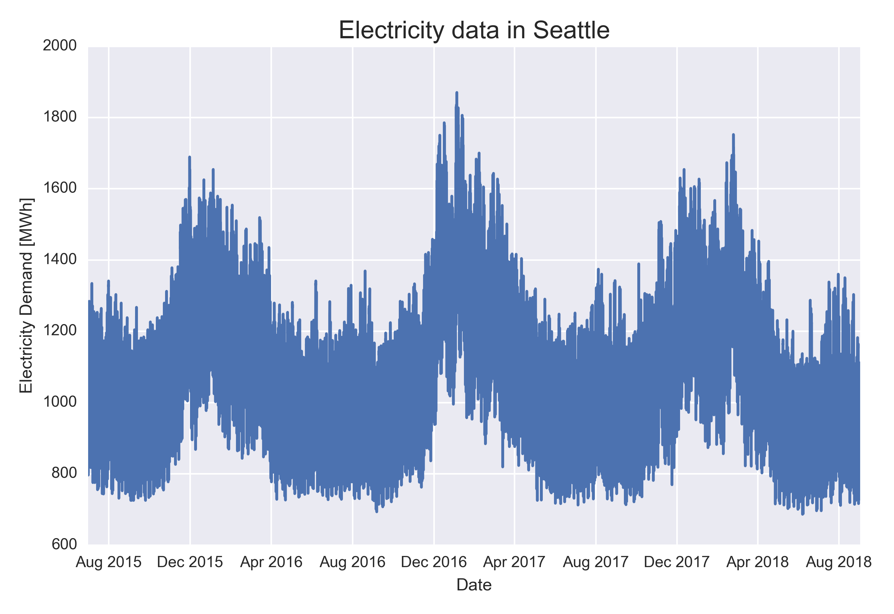
Cleaning Electricity Data
Electricity demand is measured in megawatt-hours (MWh) and had few outliers
Removing outliers reduced the size of the data set by ~.01% and ~.7% for LA and Seattle respectively

Slide 9
Cleaning Weather (LCD) Data
Dropped monthly and daily measurements, since we are only interested in hourly granularity
-Kept daily heating degree and cooling degree days (HDD/CDD) since they are an important indicator of energy demand
Multiple entries per hour, whereas electricity data only had one measurement per hour
-Kept measurement closest to the hour per hour such that LCD data will align with electricity data

Slide 10
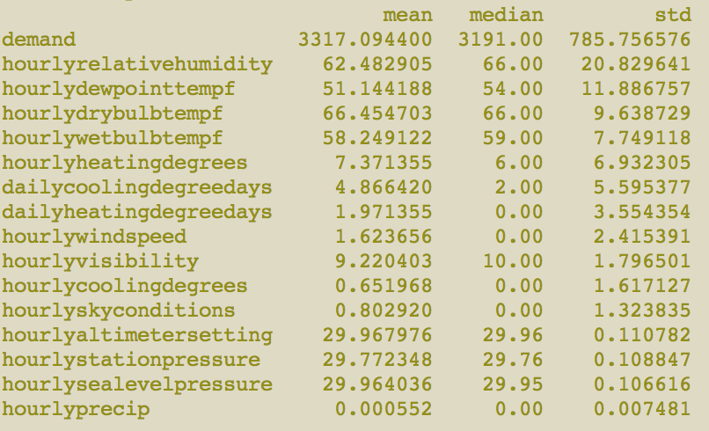
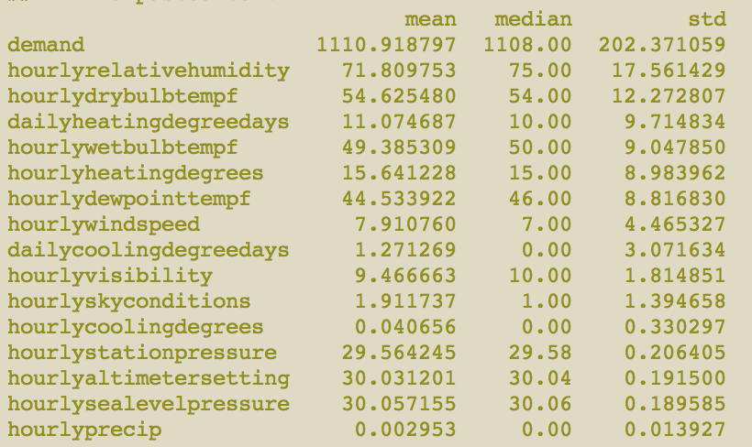
Null values in weather data
Since mean values are not too far away from median values, the median and pandas’ ffill function were used to fill null values for LCD data
LA feature statistics
Seattle feature statistics

Slide 11
Combined Data Set
All together, our combined data set contains electricity and weather data from both LA and Seattle, from July 2015 to September 2018 with a total of ~54K data points to be used for training

Slide 12
Outline
Abstract
Data Wrangling and Cleaning
Exploratory Data Analysis
Machine learning and modelling
Using RNNs and LSTM
Comparison to other forecasts
Conclusion

Slide 13
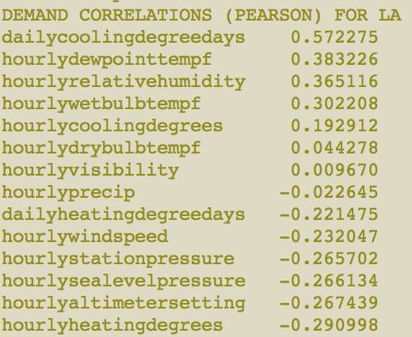
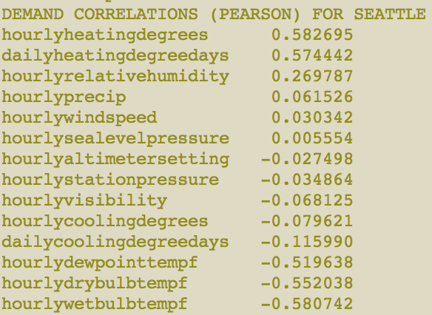
Initial Demand Correlations
Computed Pearson Correlation Coefficients between LCD data (x-variables) and electricity demand (y-variables)

Slide 14
Initial Demand Correlations
Computed Pearson Correlation Coefficients between LCD data (x-variables) and electricity demand (y-variables)

Slide 15
What’s going on here?
Demand peaks in the SUMMER in LA, while demand peaks in the WINTER in Seattle, leading to opposite correlations

Slide 16
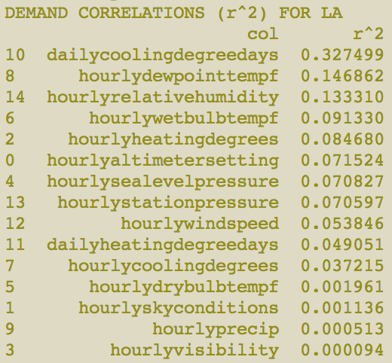
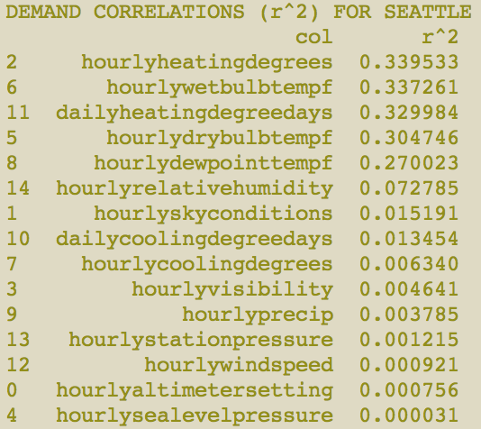
R² correlations

Slide 17
R² correlations
Collinearities in pressure and temperature

Slide 18
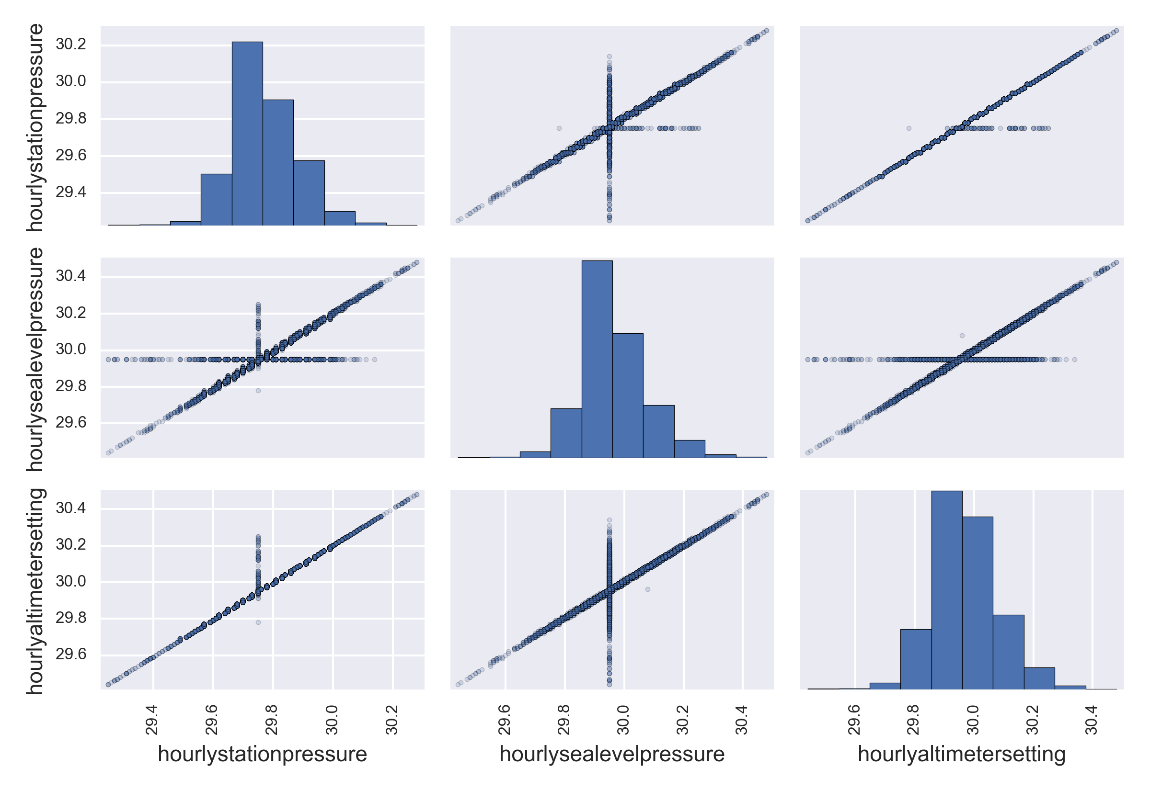
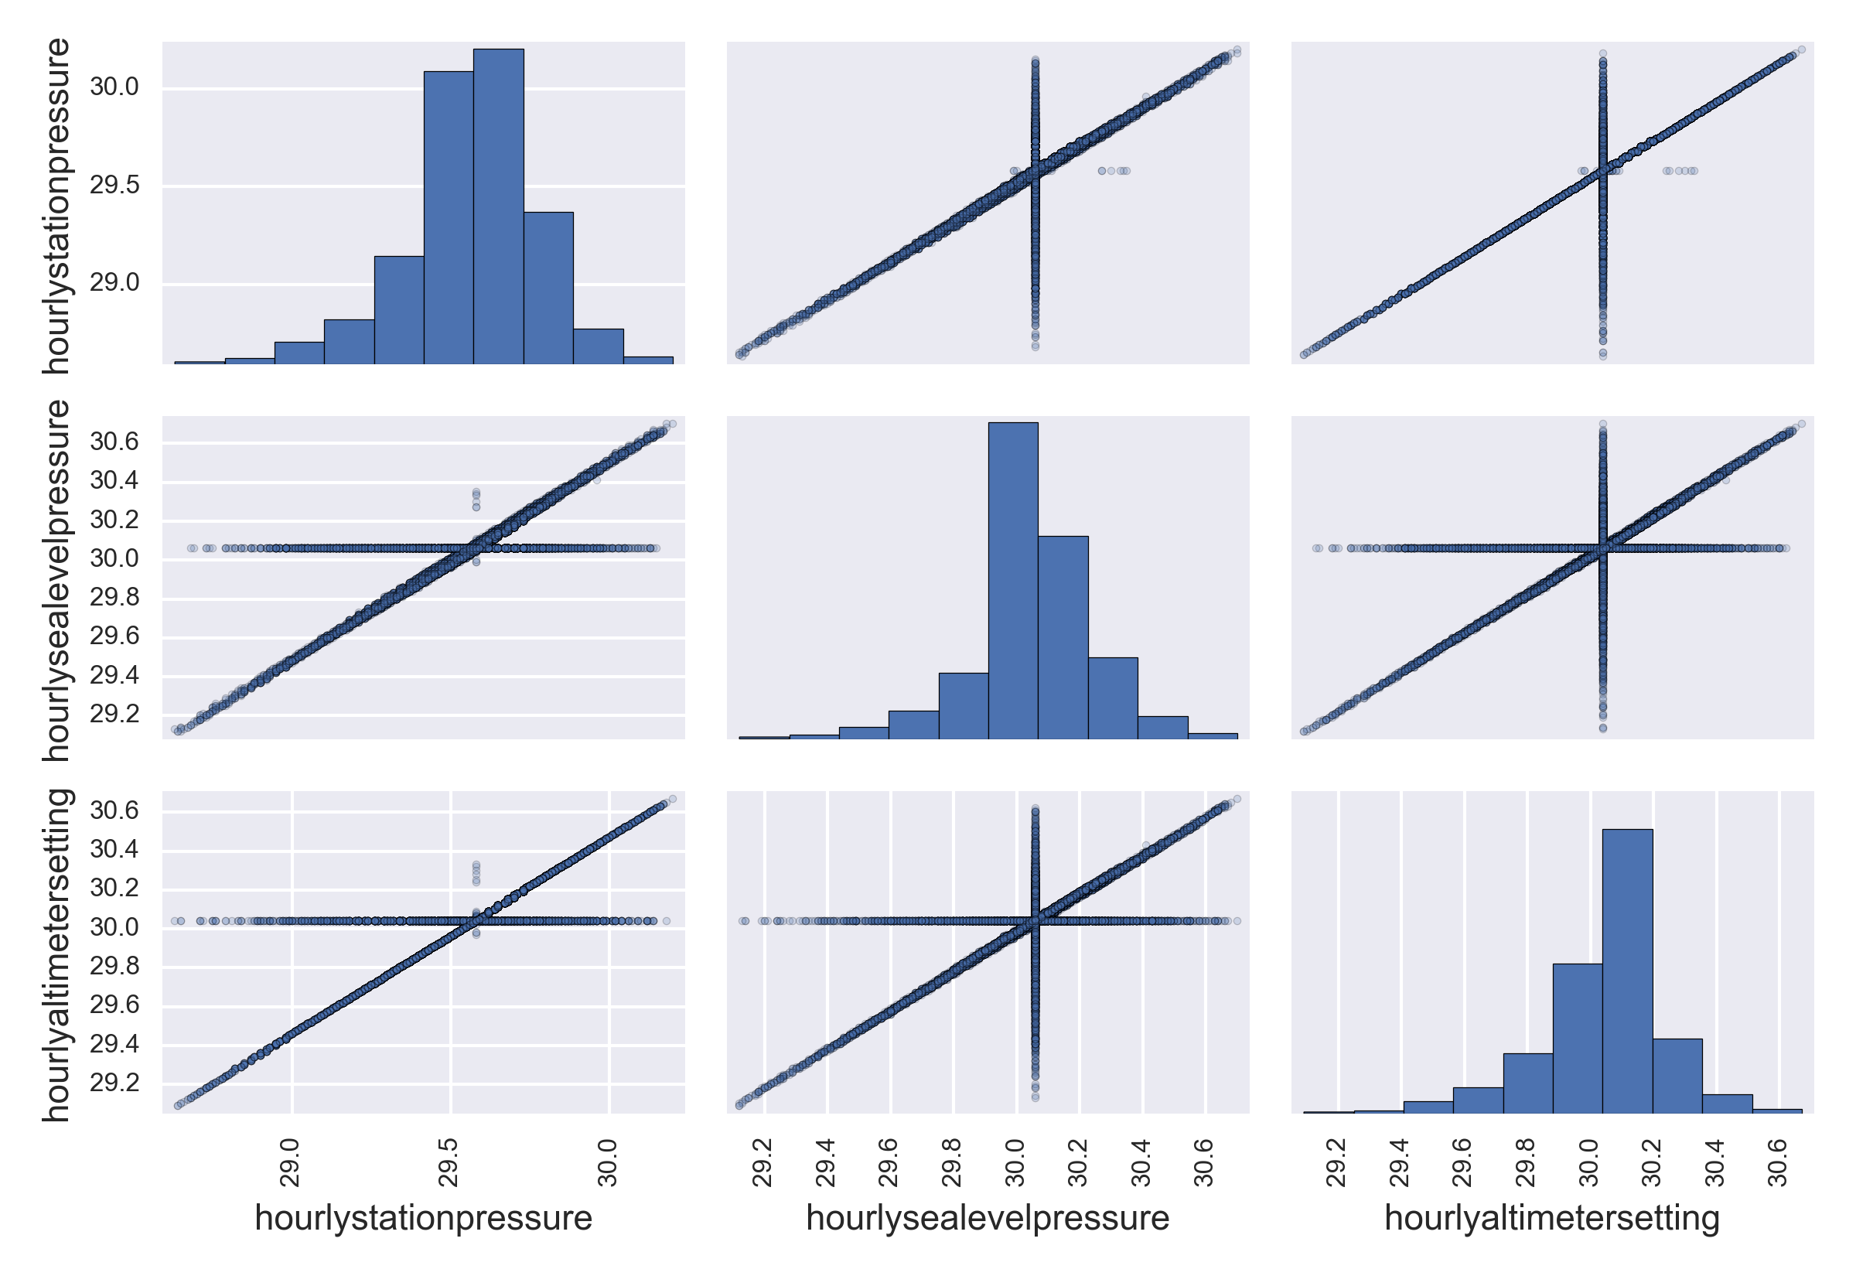
Pressure collinearities
LA
Seattle

Slide 19
Pressure collinearities
LA
Seattle
Dropped all but station pressure

Slide 20
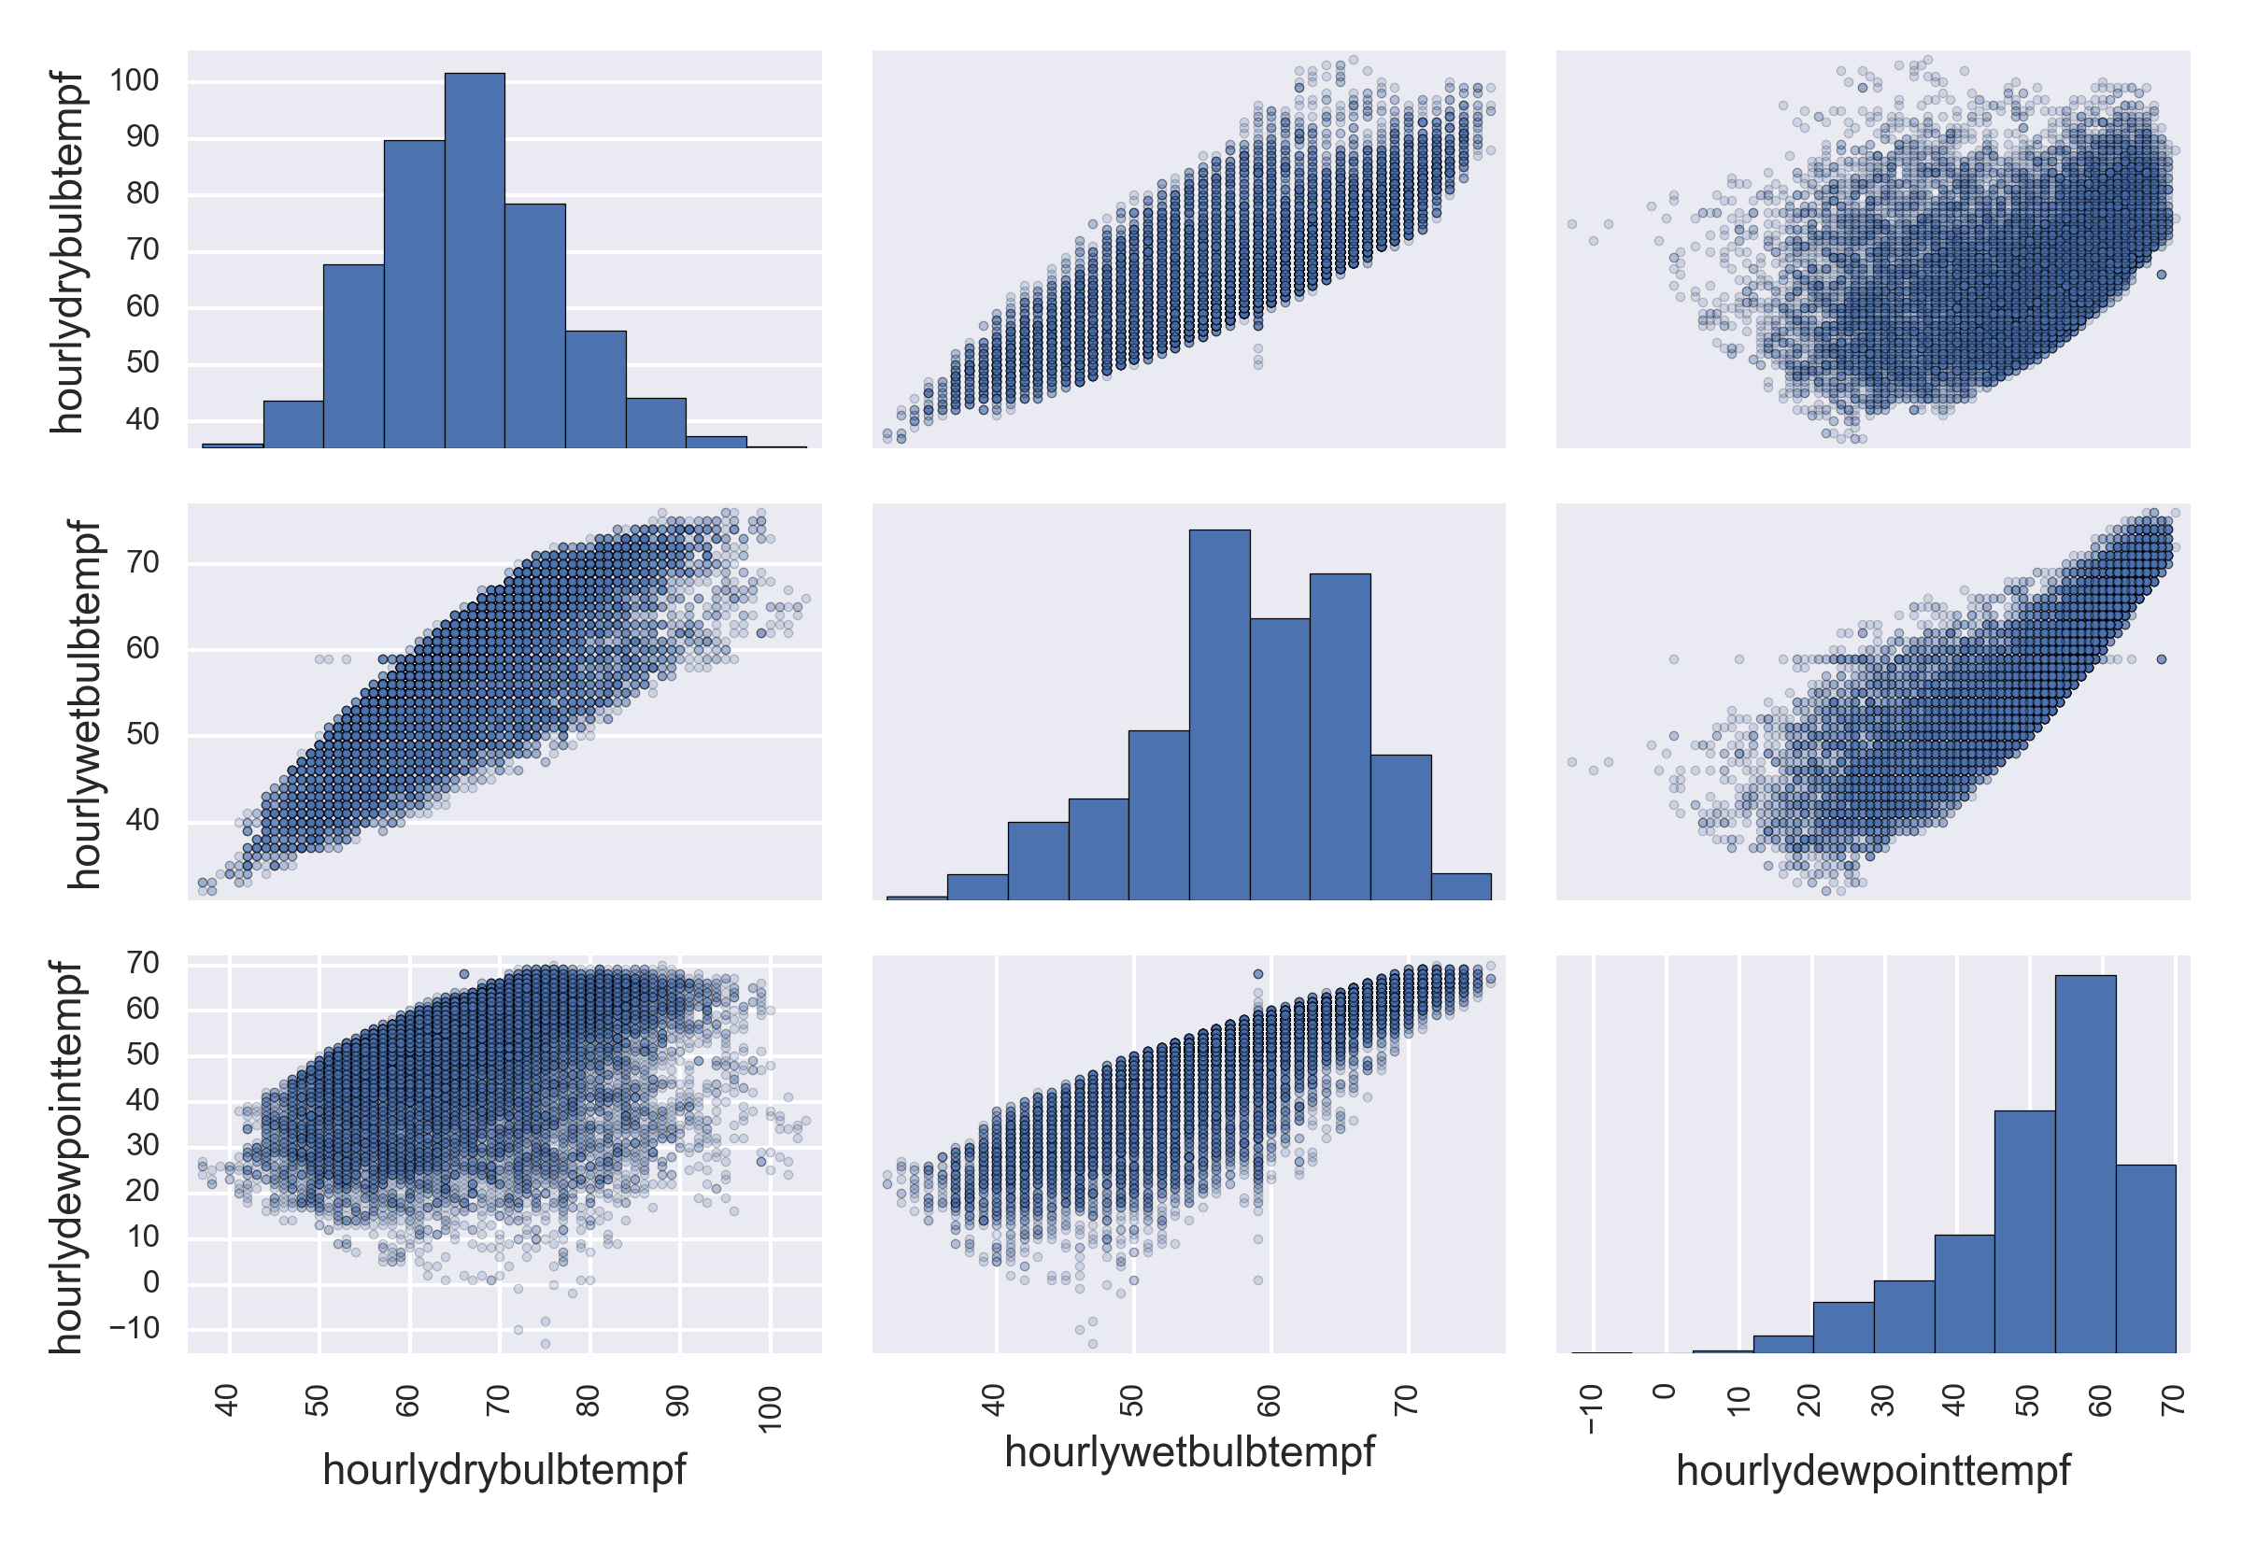
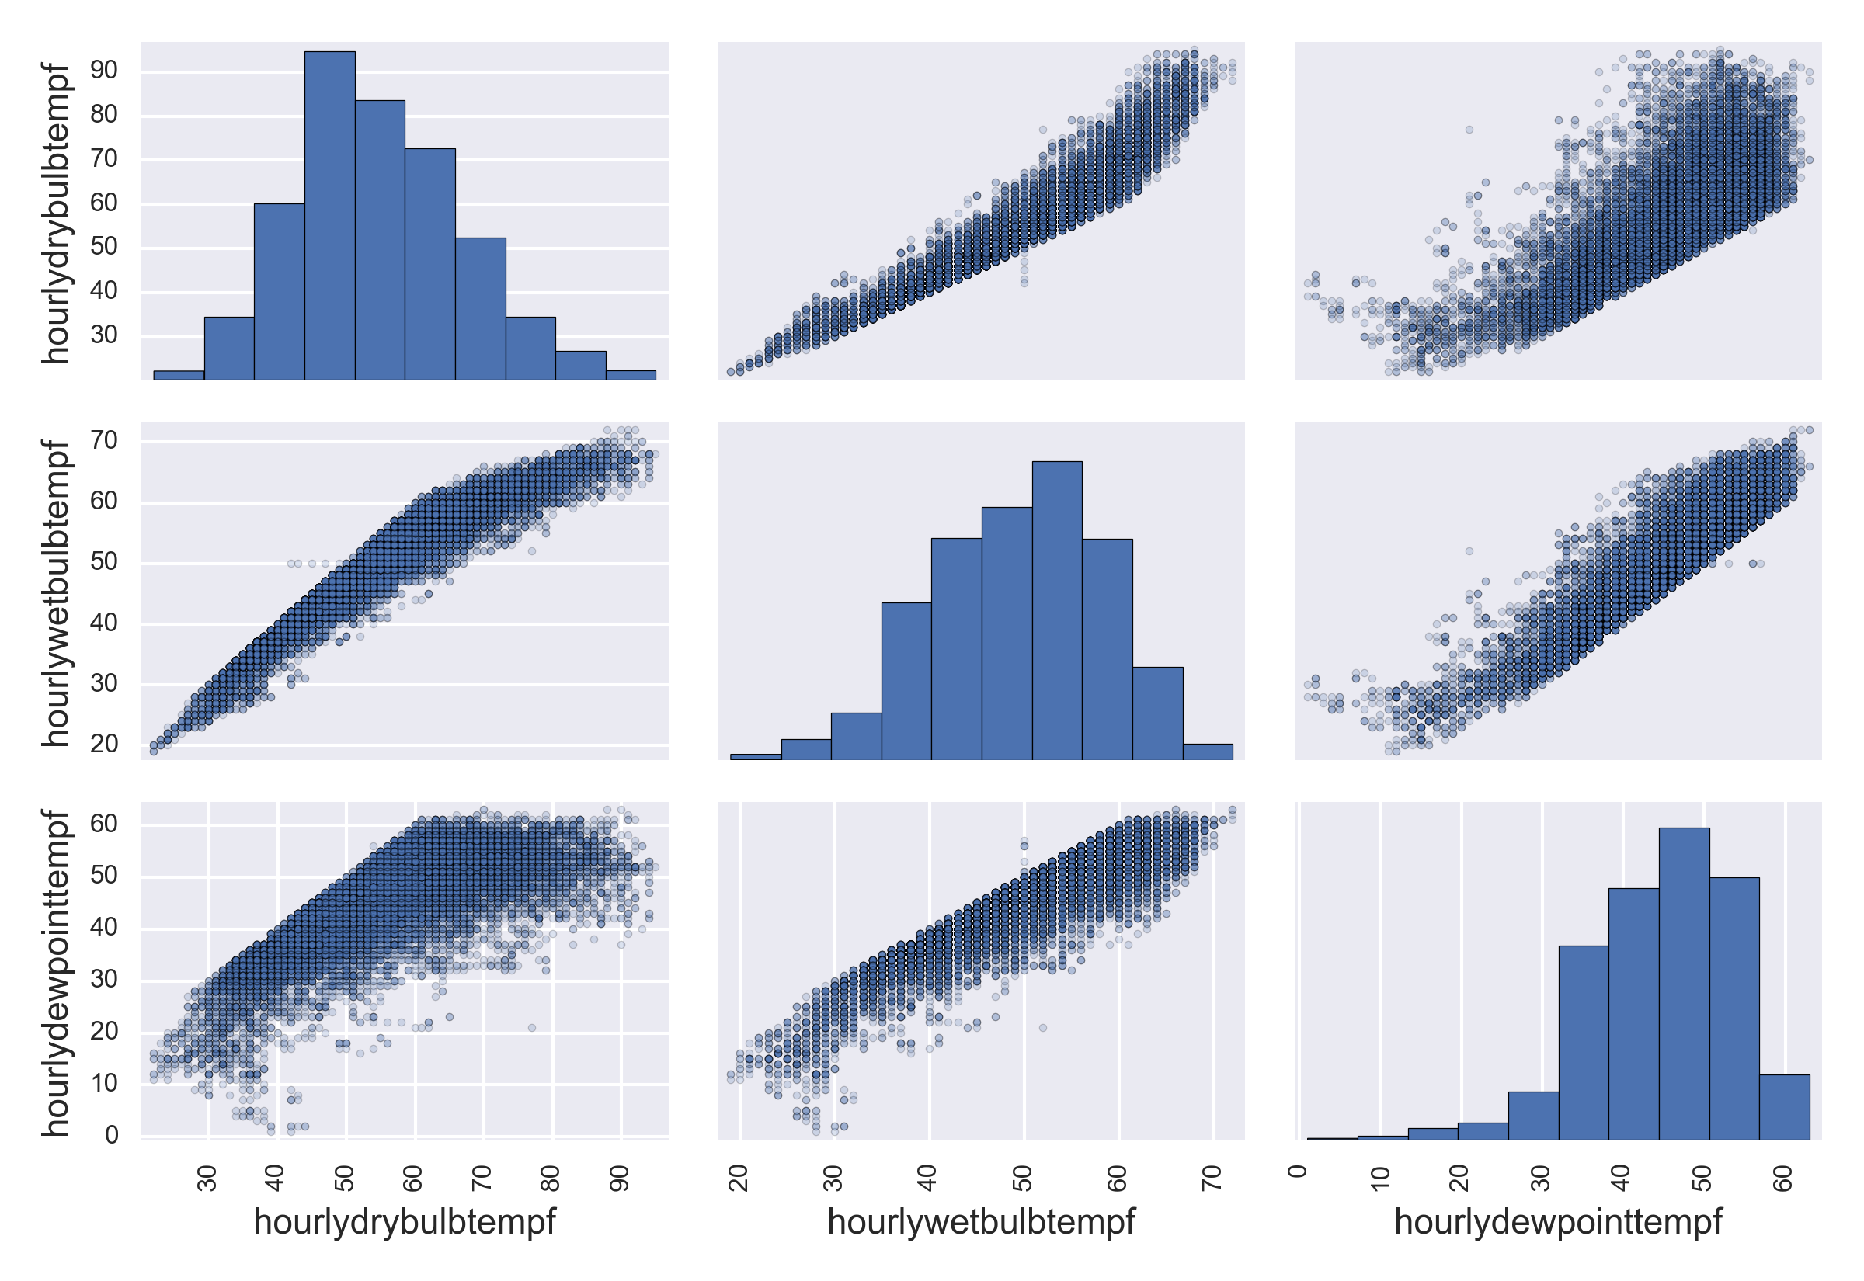
Temperature collinearities
LA
Seattle

Slide 21
Pressure collinearities
LA
Seattle
Dropped all but dew point temperature

Slide 22
Multivariate regression: LA

Slide 23
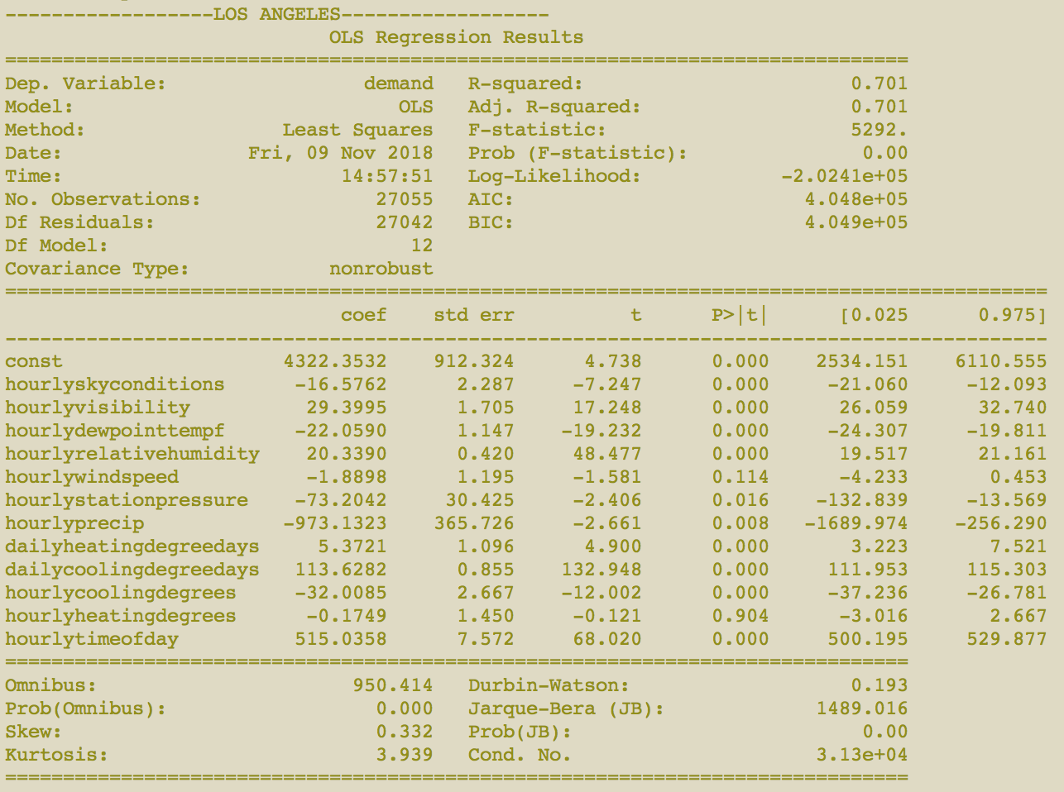

Slide 24
Multivariate regression: Seattle

Slide 25
